Slide 1

Software development life cycle (SDLC)
Waterfall Model

Slide 2
Software Development Life Cycle (SDLC)
Software Development Life Cycle (SDLC) is a process used by the software industry to design, develop and test high quality softwares.
The SDLC aims to produce a high-quality software that meets or exceeds customer expectations, reaches completion within times and cost estimates.

Slide 3
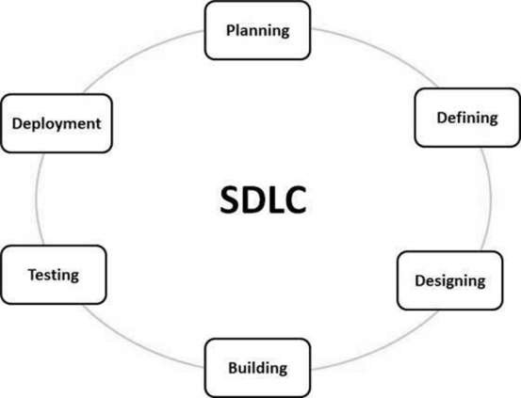
graphical representation of the various stages of a typical SDLC.

Slide 4
Software Development Life Cycle (SDLC)
There are many types of SDLC models such as:
Waterfall Model
Iterative Model
Spiral Model
V-Model
Big Bang Model
Agile Model
RAD Model

Slide 5
Waterfall model
-The Waterfall Model was the first Process Model to be introduced for SDLC.
-It is also referred to as a linear-sequential life cycle model.
-each phase must be completed before the next phase can begin and there is no overlapping in the phases.
-In this Waterfall model, typically, the outcome of one phase acts as the input for the next phase sequentially.

Slide 6
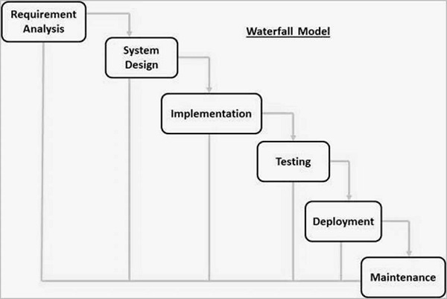
Phases of Waterfall model

Slide 7
Requirement Gathering and analysis − Is a description of a system behavior to be developed. Usually, it is the information provided by clients. Hence, it establishes the agreement between the clients and the developers for the software specifications and features. In short, requirements are gathered, analyzed and then proper documentation is prepared, which helps further in the development process
System Design − The requirement specifications from first phase are studied in this phase and the system design is prepared. This system design helps in specifying hardware and system requirements and helps in defining the overall system architecture. It is the process of planning and problem solving for a software solution. It deals with choosing the appropriate algorithm design, software architecture design, database conceptual schema, logical diagram design, and data structure definition.

Slide 8
Implementation (coding)− With inputs from the system design, the system is first developed in small programs called units, which are integrated in the next phase. Each unit is developed and tested for its functionality, which is referred to as Unit Testing.
Integration and Testing − All the units developed in the implementation phase are integrated into a system after testing of each unit. Post integration the entire system is tested for any faults and failures.
Deployment of system − Once the functional and non-functional testing is done; the product is deployed in the customer environment or released into the market.
Maintenance − There are some issues which come up in the client environment. To fix those issues, patches are released. Also to enhance the product some better versions are released. Maintenance is done to deliver these changes in the customer environment.

Slide 9
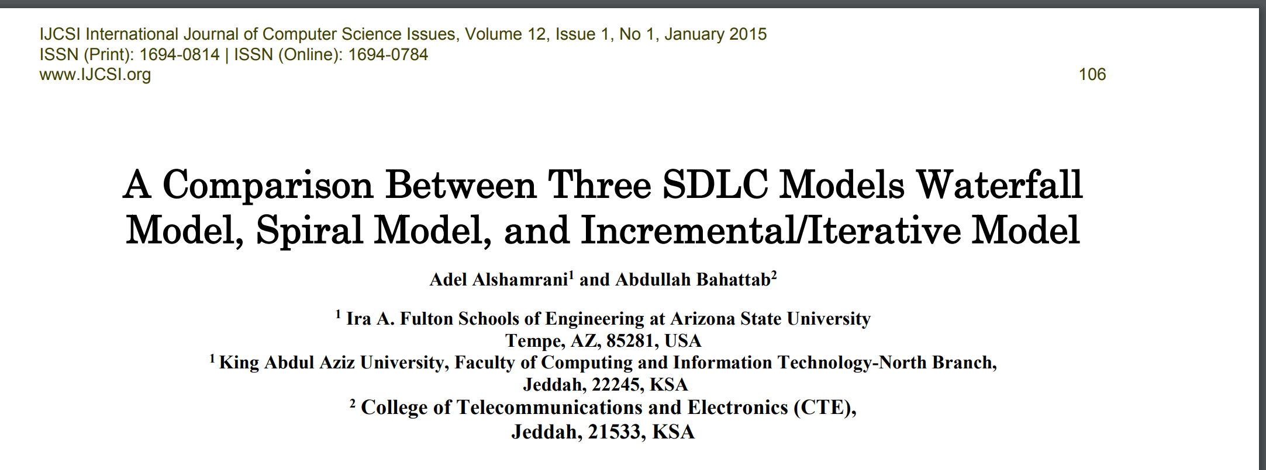
Research study
-

Slide 10
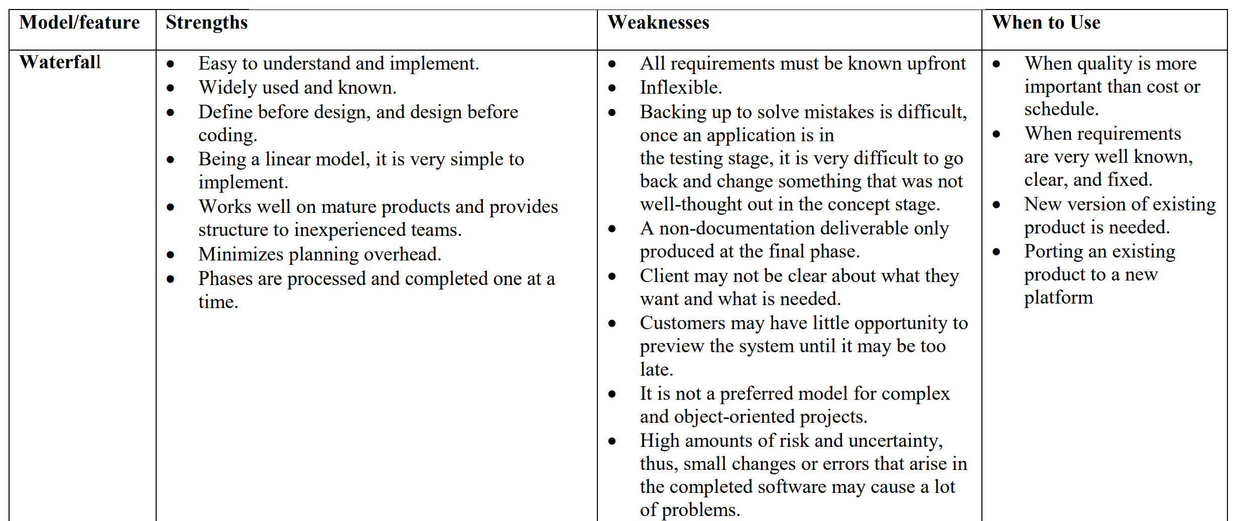
-

Slide 11
Model | waterfall
Specification of all the requirements in the beginning | Yes
Long term project | Inappropriate
Complex project | Inappropriate
Frequently change requirement | Inappropriate
Cost | Not costly
Cost estimation | Easy to estimate
Flexibility | Not
Simplicity | Simple
Supporting high risk projects | Inappropriate
Guarantee of success | Less
Customer involvement | Low
Testing | Late
Maintenance | Least maintainable
Ease of Implementation | Easy
-

Slide 12
Conclusion
-There are many models to use for SDLC.
-Each models has its own advantages and disadvantages.
-Choose model that fits

